Slide 1
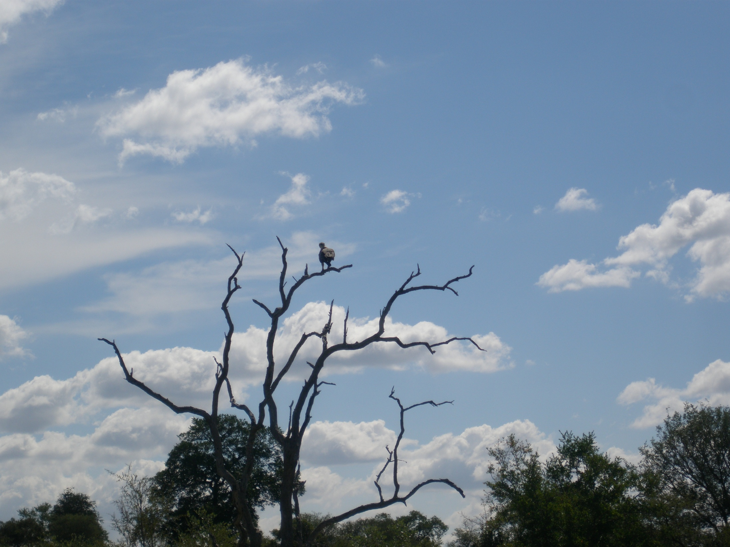
به نام خدا
الهی از من آهی و از تو نگاهی

Slide 2
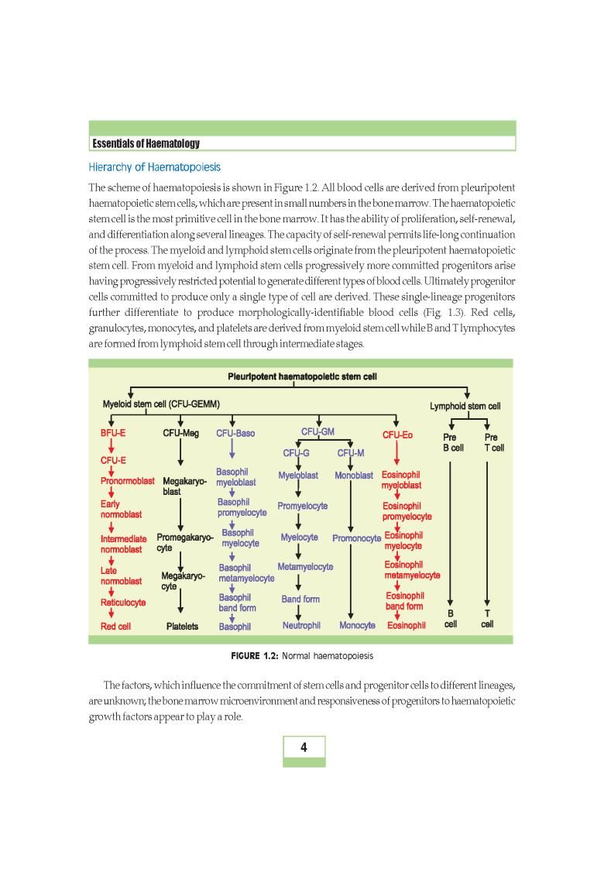

Slide 3
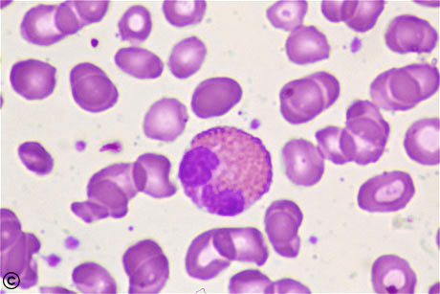
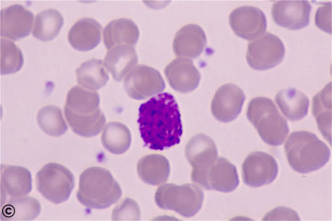
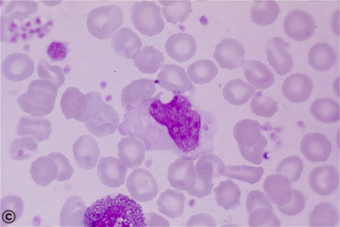
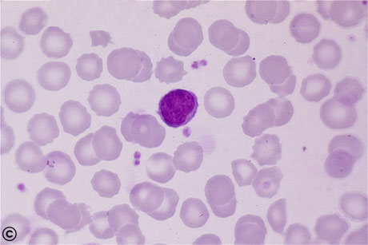

Slide 4
Leukocytosis is defined as a WBC more 11,000/microL in adults.
Leukocytosis to values in excess of 50,000/microL, when due to causes other than leukemia, has been called a leukemoid reaction
Left shift — left shift is a band form count greater than 700/microL, a condition often called "bandemia."

Slide 5
Classification of neutrophilia
Primary (no other evident associated disease)
Hereditary neutrophilia
Chronic idiopathic neutrophilia
Myeloproliferative disorders (eg, CML, PV,ET)
Familial myeloproliferative disease
Congenital anomalies and leukemoid reaction
Down syndrome
Leukocyte adhesion factor deficiency
Familial cold urticaria and leukocytosis

Slide 6
Secondary
Infection
Stress (physical or emotional stress, vigorous exercise)
Myocardial infarction
Cigarette smoking
Drugs
Glucocorticoids
Catecholamines (epinephrine)
Lithium
Recombinant G-CSF or GM-CSF*
All-trans retinoic acid
Isolated case reports for occasional other drugs
Nonhematologic malignancy
Heatstroke
Generalized marrow stimulation (as in hemolysis)
Asplenia and hyposplenism

Slide 7
Relation of absolute neutrophil count to risk of infection
Absolute neutrophil count/microL | Risk management
>1500 | None
1000-1500 | No significant risk of infection; fever can be managed on an outpatient basis
500-1000 | Some risk of infection; fever can occasionally be managed on an outpatient basis
<500 | Significant risk of infection; fever should always be managed on an inpatient basis with parenteral antibiotics; few clinical signs of infection
<200 | Very significant risk of infection; fever should always be managed on an inpatient basis with parenteral antibiotics; few or no clinical signs of infection

Slide 8
Infection
Bacterial
Parasitic
Rickettsial
Viral - eg, hepatitis B, Epstein-Barr virus, HIV,HCV
Collagen vascular diseases
Felty's syndrome
Systemic lupus erythematosius
Complement activation
Hemodialysis
Drug-induced neutropenia
Clozapine
Thionamides
Sulfasalazine
Autoimmune
Benign of childhood and adult chronic form
Large granular lymphocyte syndrome
Isoimmune neutropenia
Transfusion reaction
Chronic idiopathic neutropenia
Pure white cell aplasia
Hypersplenism
Nutritional deficiency
Alcoholism
Vitamin B12 or folate deficiency
Diseases affecting the bone marrow*
Postchemotherapy
Hypoplasia (aplastic anemia, Fanconi anemia)
Acute and chronic leukemia
Classification of neutropenias
Acquired

Slide 9
Congenital
Severe infantile agranulocytosis
Shwachman-Diamond-Oski syndrome
Myelokathexis/neutropenia with tetraploid leukocytes
Cyclic neutropenia
Chediak-Higashi syndrome
Reticular dysgenesis
Dyskeratosis congenita Myeloperoxidase deficiency (spurious)

Slide 10
NCI Common Terminology Criteria for Adverse Events grading of hematologic toxicity
Blood element (units) | Grade 1 | Grade 2 | Grade 3 | Grade 4 | Grade 5
Neutrophils | <LLN to 1500/mm³ | 1000 to 1500/mm³ | 500 to 1000/mm³ | <500/mm³
Platelets | <LLN to 75,000/mm³ | 50,000 to 75,000/mm³ | 25,000 to 50,000/mm³ | <25,000/mm³
Hemoglobin | <LLN to 10 g/dL | 8.0 to 10.0 g/dL | <8.0 g/dL | Life-threatening consequences; urgent intervention indicated | Death
CD4 count | <LLN to 500/mm³ | 200 to 500/mm³ | 50 to 200/mm³ | <50/mm³
Lymphocytopenia | <LLN to 800/mm³ | 500 to 800/mm³ | 200 to 500/mm³ | <200/mm³

Slide 11
ANC = WBC (cells/microL) x percent (PMNs + bands) ÷ 100

Slide 12
Major drugs with a definite association with agranulocytosis
Antithyroid drugs (thionamides)
Methimazole
Gastrointestinal drugs
Sulfasalazine
Antiinflammatory drugs
Sulfasalazine
Nonsteroidal antiinflammatory drugs
Gold salts
Antibacterial drugs
Macrolides
Trimethoprim-sulfamethoxazole
Chloramphenicol
Sulfonamides
Semisynthetic penicillins
Vancomycin
Psychotropic drugs
Clozapine
Phenothiazines
Cardiovascular drugs
Antiarrhythmic agents
Ticlopidine

Slide 13
Eosinophil-associated diseases and disorders
Allergic diseases
Infectious diseases
Hematologic and neoplastic disorders
Immunologic reactions
Endocrine
Diseases with specific organ involvement
drug reactions

Slide 14
Lymphocytopenia has been variously defined as an ALC <1000 or <1500 cells/microL
In subjects more than 12 years of age, lymphocytosis is defined as an ALC >4000/microL
T-cells — 60 to 80 percent (CD3+ cells)
B-cells — 10 to 20 percent (CD20+ cells)
NK-cells — 5 to 10 percent (CD56+ cells).

Slide 15
Causes of lymphocytopenia
Infection
Bacterial (eg, tuberculosis, typhoid fever)
Viral (eg, HIV, severe acute respiratory syndrome [SARS], measles, hepatitis)
Congenital immunodeficiency disorders
Iatrogenic
Immunosuppressive agents (eg, glucocorticoids, anti-lymphocyte globulin)
Chemotherapy, hematopoietic cell transplantation
Radiation therapy
Systemic disease
Autoimmune disorders (eg, systemic lupus erythematosus, rheumatoid arthritis)
Lymphoma
Other malignancies
Sarcoidosis
Renal failure
Aplastic anemia, pancytopenia
Cushing's disease

Slide 16
Other causes
Alcohol abuse
Zinc deficiency
Malnutrition, stress, exercise, trauma
Thoracic duct leak, rupture, diversion
Protein-losing enteropathy
Idiopathic CD4+ lymphocytopenia

Slide 17
Causes of reactive lymphocytosis
Infections
Viral | Infectious mononucleosis (Epstein-Barr virus)
 | Cytomegalovirus (CMV)
 | Mononucleosis syndrome (adenovirus type 12, herpes virus-6)
 | HIV-1 (during early seroconversions associated with CMV) (chronic, associated with post-splenectomy state)
 | HTLV-1 associated benign T-cell lymphocytosis
 | Mumps, varicella, influenza, hepatitis, rubella, roseola
 | Infectious lymphocytosis (Coxsackie virus B2, enteroviruses including poliovirus, others)
Bacterial | Pertussis
 | (Occasional) cat-scratch fever, tuberculosis, brucellosis, syphilis

Slide 18
Protozoal | Toxoplasmosis
Parasitic | Babesiosis
Rickettsial | (Occasional) scrub typhus
Hypersensitivity | Drug-induced
 | Serum sickness
Stress | Post trauma
 | Post splenectomy
 | Cigarette smokers
Autoimmune | Lymphocytosis of large granular lymphocytes
 | Rheumatoid arthritis
 | Malignant thymoma
Endocrine | Hyperthyroidism
Pre-malignant states | B-cell lymphoproliferative disease

